Slide 1
Word Embeddings
Word Embeddings are numeric representations of words in a lower-dimensional space, capturing semantic and syntactic information.
They play a vital role in Natural Language Processing (NLP) tasks.
In this lecture, we explore traditional and neural approaches, such as
TF-IDF
Word2Vec
GloVe
Understanding the importance of pre-trained word embeddings, providing a comprehensive understanding of their applications in various NLP scenarios.

Slide 2
What is Word Embedding in NLP?
Word Embedding is an approach for representing words and documents.
Word Embedding or Word Vector is a numeric vector input that represents a word in a lower-dimensional space.
It allows words with similar meanings to have a similar representation.
Word Embeddings are a method of extracting features out of text so that we can input those features into an ML model to work with text data.
They try to preserve syntactical and semantic information.

Slide 3
Methods
The methods such as
Bag of Words (BOW)
CountVectorizer
TFIDF
rely on the word count in a sentence but do not save any syntactical or semantic information.
In these algorithms, the size of the vector is the number of elements in the vocabulary.
We can get a sparse matrix if most of the elements are zero.
Large input vectors will mean a huge number of weights which will result in high computation required for training.
Word Embeddings give a solution to these problems.

Slide 4
Need for Word Embedding?
To reduce dimensionality
To use a word to predict the words around it.
Inter-word semantics must be captured.

Slide 5
How are Word Embeddings used?
They are used as input to machine learning models.
Take the words→Give their numeric representation→Use in training/inference
To represent or visualize any underlying patterns of usage in the corpus that was used to train them.

Slide 6
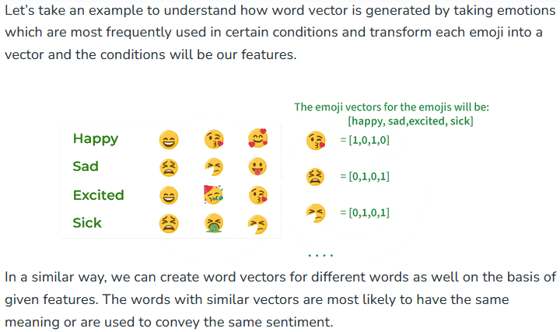

Slide 7
Approaches for Text Representation
1. Traditional Approach
The conventional method involves compiling a list of distinct terms and giving each one a unique integer value, or id. and after that, insert each word’s distinct id into the sentence.
Every vocabulary word is handled as a feature in this instance.
Thus, a large vocabulary will result in an extremely large feature size.
1.1. One-Hot Encoding
1.2. Bag of Word (Bow)
1.3. Term frequency-inverse document frequency (TF-IDF)
2. Neural Approach
2.1. Word2Vec
2.2. Continuous Bag of Words(CBOW)
2.3. Skip-Gram

Slide 8
1.1. One-Hot Encoding
One-hot encoding is a simple method for representing words in natural language processing (NLP).
In this encoding scheme, each word in the vocabulary is represented as a unique vector, where the dimensionality of the vector is equal to the size of the vocabulary.
The vector has all elements set to 0, except for the element corresponding to the index of the word in the vocabulary, which is set to 1.

Slide 9
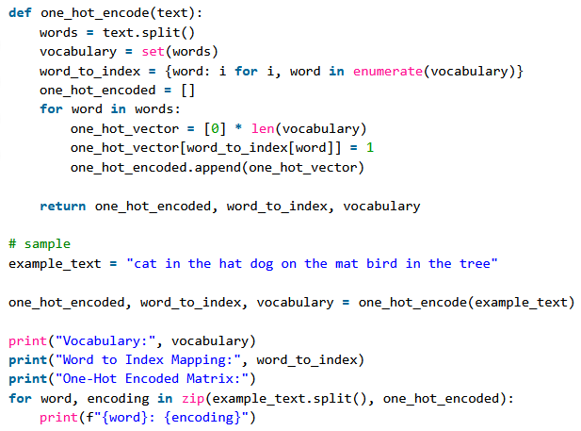

Slide 10
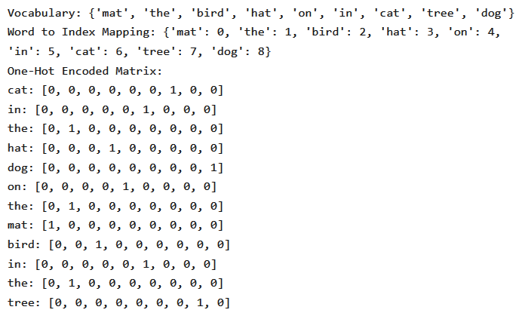

Slide 11
Disadvantages of one-hot encoding
While one-hot encoding is a simple and intuitive method for representing words in NLP, it has several disadvantages, which may limit its effectiveness in certain applications.
It results in high-dimensional vectors, making it computationally expensive and memory-intensive, especially with large vocabularies.
It does not capture semantic relationships between words; each word is treated as an isolated entity without considering its meaning or context.
It is restricted to the vocabulary seen during training, making it unsuitable for handling out-of-vocabulary words.

Slide 12
1.2. Bag of Word (Bow)
Bag-of-Words (BoW) is a text representation technique that represents a document as an unordered set of words and their respective frequencies.
It discards the word order and captures the frequency of each word in the document, creating a vector representation.

Slide 13
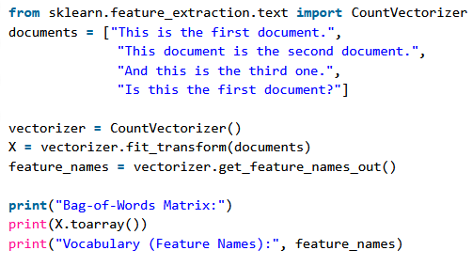
Sample Program

Slide 14
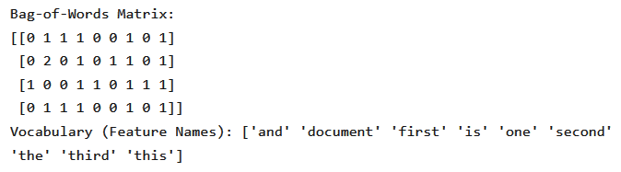
Sample Output

Slide 15
Disadvantages of BoW
While BoW is a simple & interpretable representation, below disadvantages highlight its limitations in capturing certain aspects of language structure and semantics:
BoW ignores the order of words in the document, leading to a loss of sequential information and context making it less effective for tasks where word order is crucial, such as in natural language understanding.
BoW representations are often sparse, with many elements being zero resulting in increased memory requirements and computational inefficiency, especially when dealing with large datasets.

Slide 16
Example: Sample paragraph for BoW
Beans. I was trying to explain to somebody as we were flying in, that's corn. That's beans. And they were very impressed at my agricultural knowledge. Please give it up for Amaury once again for that outstanding introduction. I have a bunch of good friends here today, including somebody who I served with, who is one of the finest senators in the country, and we're lucky to have him, your Senator, Dick Durbin is here. I also noticed, by the way, former Governor Edgar here, who I haven't seen in a long time, and somehow he has not aged and I have. And it's great to see you, Governor. I want to thank President Killeen and everybody at the U of I System for making it possible for me to be here today. And I am deeply honored at the Paul Douglas Award that is being given to me. He is somebody who set the path for so much outstanding public service here in Illinois. Now, I want to start by addressing the elephant in the room. I know people are still wondering why I didn't speak at the commencement.

Slide 17
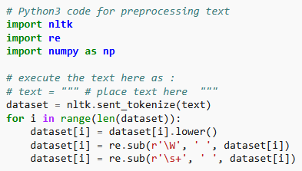
Step #1 : We will first preprocess the data
In order to:
Convert text to lower case.
Remove all non-word characters.
Remove all punctuations.

Slide 18
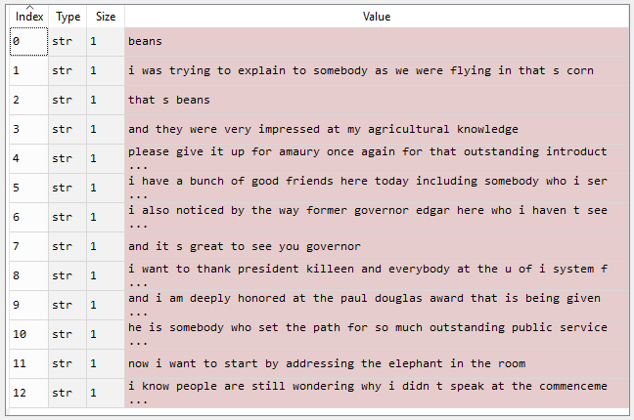
Output: Preprocessed text

Slide 19
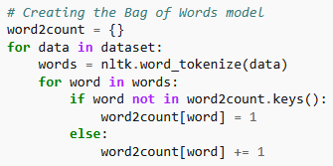
Step #2 : Obtaining most frequent words in our text
We will apply the following steps to generate our model.
We declare a dictionary to hold our bag of words.
Next we tokenize each sentence to words.
Now for each word in sentence, we check if the word exists in our dictionary.
If it does, then we increment its count by 1.
If it doesn't, we add it to our dictionary and set its count as 1.

Slide 20
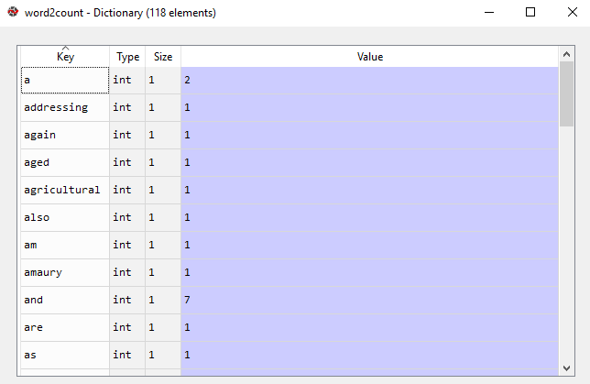
Output: Bag of Words dictionary

Slide 21
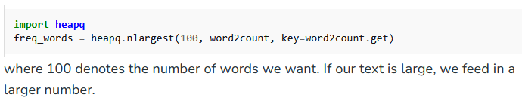
Step #2.5: select the most frequently used words
In our model, we have a total of 118 words.
However when processing large texts the number of words could reach millions
We do not need to use all those words.
Hence, we select a particular number of most frequently used words.
To implement this we use:

Slide 22
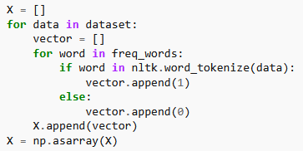
Step #3 : Building the Bag of Words model
In this step we construct a vector, which would tell us whether a word in each sentence is a frequent word or not.
If a word in a sentence is a frequent word, we set it as 1, else we set it as 0.
This can be implemented with the help of following code:

Slide 23
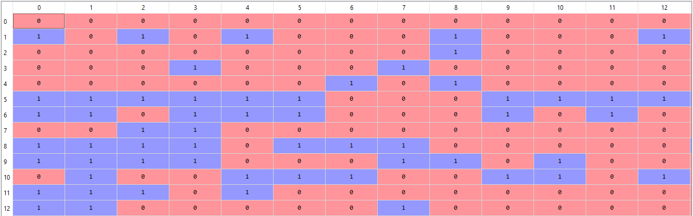
Output: BoW model

Slide 24
1.3. Term frequency-inverse document frequency (TF-IDF)
Term Frequency-Inverse Document Frequency, commonly known as TF-IDF, is a numerical statistic that reflects the importance of a word in a document relative to a collection of documents (corpus).
It is widely used in natural language processing and information retrieval to evaluate the significance of a term within a specific document in a larger corpus.

Slide 25
Where is it used?
TFIDF is widely used in text retrieval, web search engines for classification of documents.
Have you ever looked at articles on internet and wondered if it is possible to generate the tags automatically for them?
Well, that’s exactly the kind of problem TF-IDF is used to solve.
Search engines like Google use TF-IDF as one of the factors to determine the rank of a particular website in search results.

Slide 26
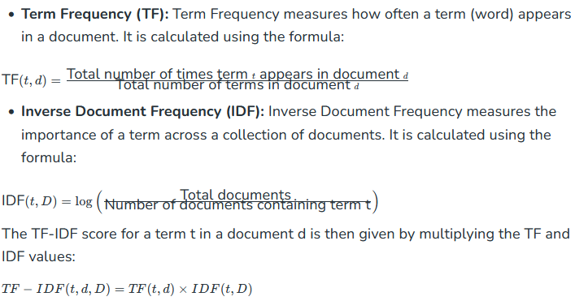
TF-IDF consists of two components:

Slide 27
weighting scheme
The higher the TF-IDF score for a term in a document, the more important that term is to that document within the context of the entire corpus.
This weighting scheme helps in identifying and extracting relevant information from a large collection of documents, and it is commonly used in text mining, information retrieval, and document clustering.

Slide 28
Formula
We can calculate TF-IDF for a term in a data set using the below formula.
TFIDF(t,d,D) = tf(t,d) * idf(t,D)
Where
tf(t,d) is the Term frequency
idf(t,D) is the Inverse document frequency.

Slide 29
Term Frequency
In simple terms, Term Frequency for a term can be calculated as (n) number of times a term t appears in a document d to the (N) total number of terms in the document.
tf(t,d) = n/N
n is the number of times term t appears in the document d.
N is the total number of terms in the document d.

Slide 30
Inverse document Frequency
Inverse document frequency can be calculated as mathematically as the logarithm of ratio of number of documents present in the data set to the number of documents that contain the term t.
This measure is essentially used to remove out the most commonly used terms in the document .
idf(t,D) = log (N/( n))
N is the number of documents in the data set.
n is the number of documents that contain the term t among the data set.

Slide 31
TFIDF Calculation
Finally TFIDF is calculated as the product of the above two values.
TFIDF(t,d,D) = tf(t,d) * idf(t,D)

Slide 32
Example
Let us assume we have two documents.
Let the term counts be as follows:
Document 1 :(This, 1 ),(Is, 1 ),(a, 3 ),(sentence,5)
Document 2: (This, 1),( Is, 2), (another, 2), (sentence,1)
We can calculate TF-IDF as follows:
Term frequency for document 1 and Document 2 would be as follows:
tf(“is”, Document1) = 1/10
tf(“is”,Document2) = 2/6

Slide 33
Calculation
Inverse Document Frequency for the data set can be calculated as follows:
idf(“this”,D) = log(2/2) = log(1) = 0
idf(“is”,D) = log(2/2) = 0
Finally TF-IDF would be :
TF-IDF(“is”,document1,D) = (1/10)*0 = 0.

Slide 34
Sample Implementation
Sample implementation of Term Frequency-Inverse Document Frequency (TF-IDF) using python with the scikit-learn library.
It begins by defining a set of sample documents.
The TfidfVectorizer is employed to transform these documents into a TF-IDF matrix.
The code then extracts and prints the TF-IDF values for each word in each document.
This statistical measure helps assess the importance of words in a document relative to their frequency across a collection of documents, aiding in information retrieval and text analysis tasks.

Slide 35
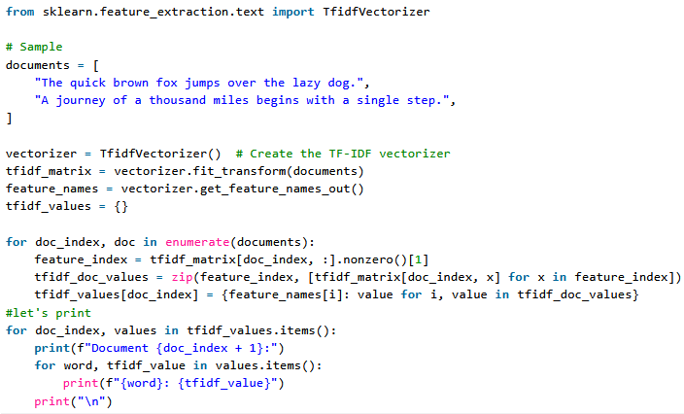

Slide 36
Output
Document 1:
dog: 0.3404110310756642
lazy: 0.3404110310756642
over: 0.3404110310756642
jumps: 0.3404110310756642
fox: 0.3404110310756642
brown: 0.3404110310756642
quick: 0.3404110310756642
the: 0.43455990318254417
Document 2:
step: 0.3535533905932738
single: 0.3535533905932738
with: 0.3535533905932738
begins: 0.3535533905932738
miles: 0.3535533905932738
thousand: 0.3535533905932738
of: 0.3535533905932738
journey: 0.3535533905932738

Slide 37
Why is TF-IDF Useful in this Example?
1. Identifying Important Terms:
TF-IDF helps us understand that “dog” is somewhat important in Document 1, but irrelevant in Document 2.
If we were building a search engine, this score would help rank Document 1 higher for a query like “dog”.
2. Filtering Common Words:
Words like “the” or “and” would have high TF scores but very low IDF scores because they appear in almost all documents.
Their TF-IDF scores would be close to 0, indicating they are not meaningful.
3. Highlighting Unique Terms:
If a term like “mat” appeared only in Document 1, it would have a higher IDF score, making its TF-IDF score more significant in that document.

Slide 38
Disadvantages of TF-IDF
TF-IDF is a widely used technique in information retrieval and text mining, but its limitations should be considered, especially when dealing with tasks that require a deeper understanding of language semantics.
For example:
TF-IDF treats words as independent entities and doesn’t consider semantic relationships between them.
This limitation hinders its ability to capture contextual information and word meanings.
Sensitivity to Document Length:
Longer documents tend to have higher overall term frequencies, potentially biasing TF-IDF towards longer documents.

Slide 39
Neural Approach
2.1. Word2Vec
2.2. Continuous Bag of Words(CBOW)
2.3. Skip-Gram

Slide 40
2.1. Word2Vec
Word2Vec is a neural approach for generating word embeddings.
It belongs to the family of neural word embedding techniques and specifically falls under the category of distributed representation models.
It is a popular technique in natural language processing (NLP) that is used to represent words as continuous vector spaces.
Developed by a team at Google, Word2Vec aims to capture the semantic relationships between words by mapping them to high-dimensional vectors.
The underlying idea is that words with similar meanings should have similar vector representations.
In Word2Vec every word is assigned a vector.
We start with either a random vector or one-hot vector.

Slide 41
There are 2 neural embedding methods for Word2Vec
Continuous Bag of Words (CBOW)
Skip-gram

Slide 42
2.2. Continuous Bag of Words(CBOW)
Continuous Bag of Words (CBOW) is a type of neural network architecture used in the Word2Vec model.
The primary objective of CBOW is to predict a target word based on its context, which consists of the surrounding words in a given window.
Given a sequence of words in a context window, the model is trained to predict the target word at the center of the window.

Slide 43
CBOW is a feedforward neural network with a single hidden layer
The input layer represents the context words, and the output layer represents the target word.
The hidden layer contains the learned continuous vector representations (word embeddings) of the input words.

Slide 44
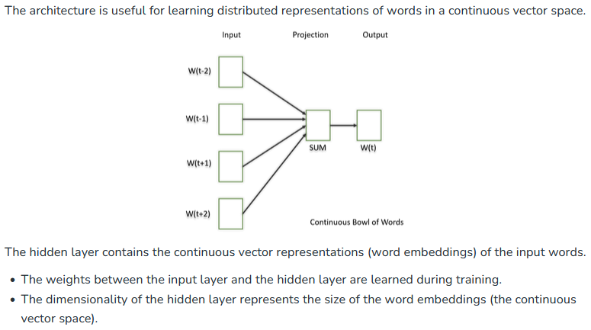

Slide 45
2.3. Skip-Gram
The Skip-Gram model learns distributed representations of words in a continuous vector space.
The main objective of Skip-Gram is to predict context words (words surrounding a target word) given a target word.
This is the opposite of the Continuous Bag of Words (CBOW) model, where the objective is to predict the target word based on its context.
It is shown that this method produces more meaningful embeddings.

Slide 46
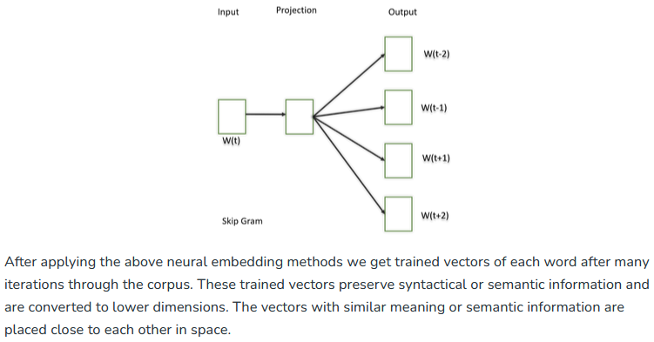

Slide 47
CBOW or Skip-gram?
In practice, the choice between CBOW and Skip-gram often depends on the specific characteristics of the data and the task at hand.
CBOW might be preferred when training resources are limited, and capturing syntactic information is important.
Skip-gram, on the other hand, might be chosen when semantic relationships and the representation of rare words are crucial.

Slide 48
Pretrained Word-Embedding
Pre-trained word embeddings are representations of words that are learned from large corpora and are made available for reuse in various natural language processing (NLP) tasks.
These embeddings capture semantic relationships between words, allowing the model to understand similarities and relationships between different words in a meaningful way.
GloVe
Fasttext
BERT (Bidirectional Encoder Representations from Transformers)

Slide 49
3.1. GloVe
GloVe is trained on global word co-occurrence statistics.
It leverages the global context to create word embeddings that reflect the overall meaning of words based on their co-occurrence probabilities.
This method, we take the corpus and iterate through it and get the co-occurrence of each word with other words in the corpus.
We get a co-occurrence matrix through this.
The words which occur next to each other get a value of 1, if they are one word apart then 1/2, if two words apart then 1/3 and so on.

Slide 50
Example:
Let us take an example to understand how the matrix is created.
We have a small corpus:
Corpus:
It is a nice evening.
Good Evening!
Is it a nice evening?

Slide 51
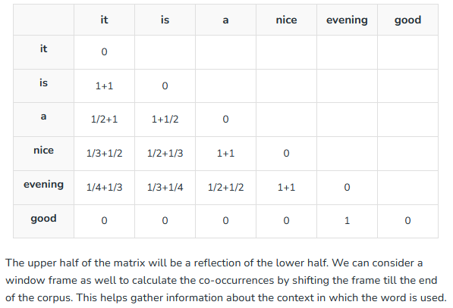

Slide 52
Initially, the vectors for each word is assigned randomly
Then we take two pairs of vectors and see how close they are to each other in space.
If they occur together more often or have a higher value in the co-occurrence matrix and are far apart in space then they are brought close to each other.
If they are close to each other but are rarely or not frequently used together then they are moved further apart in space.

Slide 53
Vector Space
After many iterations of the above process, we’ll get a vector space representation that approximates the information from the co-occurrence matrix.
The performance of GloVe is better than Word2Vec in terms of both semantic and syntactic capturing.

Slide 54
Output:
Similarity between 'learn' and 'learning' using GloVe: 0.802
Similarity between 'india' and 'indian' using GloVe: 0.865
Similarity between 'fame' and 'famous' using GloVe: 0.589

Slide 55
3.2. Fasttext
Developed by Facebook, FastText extends Word2Vec by representing words as bags of character n-grams.
This approach is particularly useful for handling out-of-vocabulary words and capturing morphological variations.

Slide 56
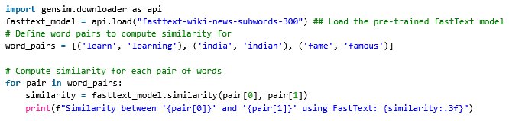
Sample Code
Output:
Similarity between 'learn' and 'learning' using FastText: 0.642
Similarity between 'india' and 'indian' using FastText: 0.708
Similarity between 'fame' and 'famous' using FastText: 0.519

Slide 57
3.3. BERT (Bidirectional Encoder Representations from Transformers)
BERT is a transformer-based model that learns contextualized embeddings for words.
It considers the entire context of a word by considering both left and right contexts, resulting in embeddings that capture rich contextual information.

Slide 58
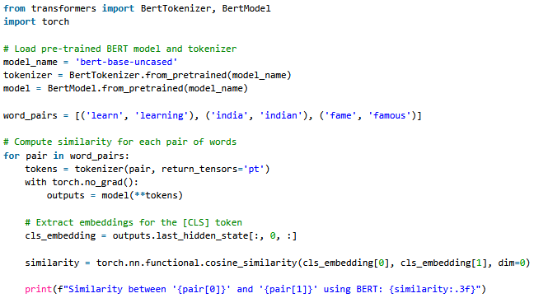
Sample Code:

Slide 59
Output:
Similarity between 'learn' and 'learning' using BERT: 0.930
Similarity between 'india' and 'indian' using BERT: 0.957
Similarity between 'fame' and 'famous' using BERT: 0.956

Slide 60
Considerations for Deploying Word Embedding Models
You need to use the exact same pipeline during deploying your model as were used to create the training data for the word embedding.
If you use a different tokenizer or different method of handling white space, punctuation etc. you might end up with incompatible inputs.
Words in your input that doesn’t have a pre-trained vector.
Such words are known as Out of Vocabulary Word(oov).
What you can do is replace those words with “UNK” which means unknown and then handle them separately.
Dimension mis-match:
Vectors can be of many lengths.
If you train a model with vectors of length say 400 and then try to apply vectors of length 1000 at inference time, you will run into errors.
So make sure to use the same dimensions throughout.

Slide 61
Advantages of Word Embeddings
It is much faster to train than hand build models like WordNet (which uses graph embeddings).
Almost all modern NLP applications start with an embedding layer.
It Stores an approximation of meaning.

Slide 62
Disadvantages of Word Embeddings
It can be memory intensive.
It is corpus dependent. Any underlying bias will have an effect on your model.
It cannot distinguish between homophones. Eg: brake/break, cell/sell, weather/whether etc.

Slide 63
Conclusion
In conclusion, word embedding techniques such as TF-IDF, Word2Vec, and GloVe play a crucial role in natural language processing by representing words in a lower-dimensional space, capturing semantic and syntactic information.

Slide 64
1. Does GPT use word embeddings?
GPT uses context-based embeddings rather than traditional word embeddings.
It captures word meaning in the context of the entire sentence.

Slide 65
2. What is the difference between Bert and word embeddings?
BERT is contextually aware, considering the entire sentence, while traditional word embeddings, like Word2Vec, treat each word independently.

Slide 66
3. What are the two types of word embedding?
Word embeddings can be broadly evaluated in two categories, intrinsic and extrinsic.
For intrinsic evaluation, word embeddings are used to calculate or predict semantic similarity between words, terms, or sentences.

Slide 67
4. How does word vectorization work?
Word vectorization converts words into numerical vectors, capturing semantic relationships.
Techniques like TF-IDF, Word2Vec, and GloVe are common.

Slide 68
5. What are the benefits of word embeddings?
Word embeddings offer semantic understanding, capture context, and enhance NLP tasks.
They reduce dimensionality, speed up training, and aid in language pattern recognition.

Slide 69
Summary
LLMs require textual data to be converted into numerical vectors, known as embeddings, since they can’t process raw text.
Embeddings transform discrete data (like words or images) into continuous vector spaces, making them compatible with neural network operations.
As the first step, raw text is broken into tokens, which can be words or characters.
Then, the tokens are converted into integer representations, termed token IDs.
Special tokens, such as <|unk|> and <|endoftext|>, can be added to enhance the model’s understanding and handle various contexts, such as unknown words or marking the boundary between unrelated texts.
The byte pair encoding (BPE) tokenizer used for LLMs like GPT-2 and GPT-3 can efficiently handle unknown words by breaking them down into subword units or individual characters.

Slide 70
Cont’d
We use a sliding window approach on tokenized data to generate input–target pairs for LLM training.
Embedding layers in PyTorch function as a lookup operation, retrieving vectors corresponding to token IDs.
The resulting embedding vectors provide continuous representations of tokens, which is crucial for training deep learning models like LLMs.
While token embeddings provide consistent vector representations for each token, they lack a sense of the token’s position in a sequence.
To rectify this, two main types of positional embeddings exist: absolute and relative.
OpenAI’s GPT models utilize absolute positional embeddings, which are added to the token embedding vectors and are optimized during the model training.

